Slide 1
Neera Tanden deletes tweets that criticized U.S. senators
By: Harveen Kaur
CS 795 - Web Archiving Forensics (Fall 2020)
Department of Computer Science

Slide 2

“The problem with tweets is that your friends never remember them. But your enemies never forget them.”
-Paul Mulshine|Star-Ledger Columnist
https://www.nj.com/opinion/2020/12/revenge-is-tweet-phil-murphys-beltway-crony-learns-after-her-posts-comes-back-to-haunt-her-mulshine.html
Harveen Kaur CS 795: Web Archiving Forensics (Fall 2020)

Slide 3

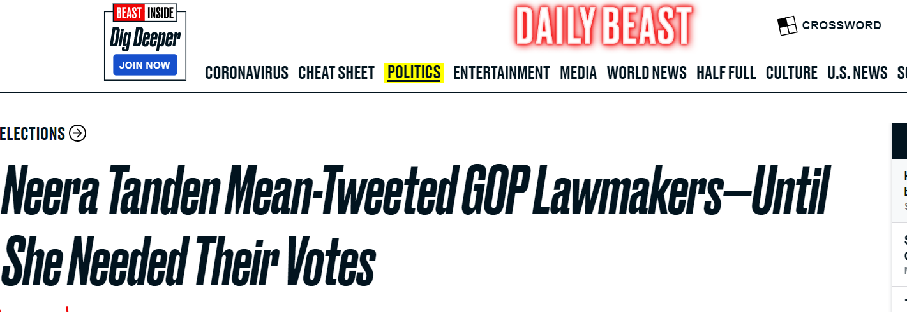
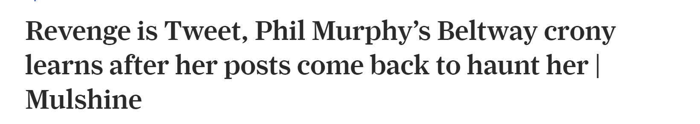
Articles on which the presentation is based
http://web.archive.org/web/20201201200141/https://www.theguardian.com/us-news/2020/dec/01/neera-tanden-deletes-tweets-office-of-management-and-budget-nominee
https://www.theguardian.com/us-news/2020/dec/01/neera-tanden-deletes-tweets-office-of-management-and-budget-nominee
https://www.nj.com/opinion/2020/12/revenge-is-tweet-phil-murphys-beltway-crony-learns-after-her-posts-comes-back-to-haunt-her-mulshine.html
https://www.thedailybeast.com/neera-tanden-mean-tweeted-gop-lawmakersuntil-she-needed-their-votes?ref=home
Harveen Kaur CS 795: Web Archiving Forensics (Fall 2020)

Slide 4
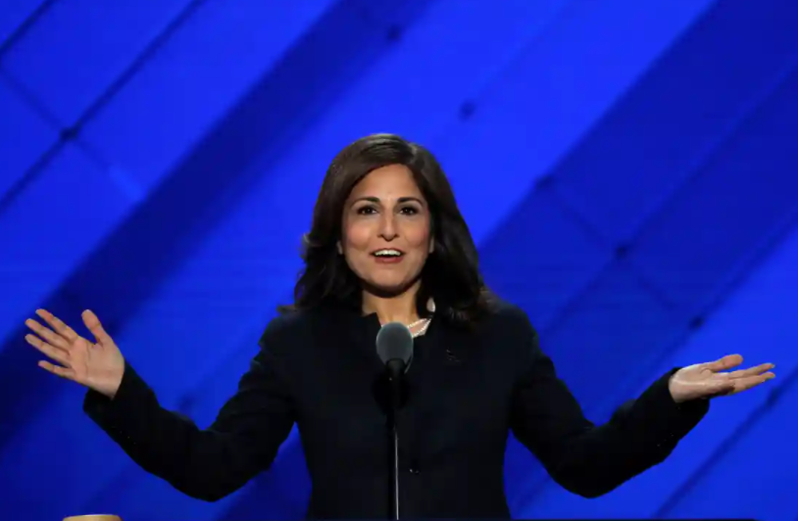
Who is Neera Tanden?
Neera Tanden is an American political consultant
President of the Center of American Progress
Joe Biden’s nominee for director of the White House Office of Management and Budget (OMB)
The OMB position requires Senate confirmation
Mitch McConnell, Susan Collins, John Cornyn, Bernie Sanders and David Perdue are some of the senators she has criticized
https://en.wikipedia.org/wiki/Neera_Tanden
https://www.theguardian.com/us-news/2020/dec/01/neera-tanden-deletes-tweets-office-of-management-and-budget-nominee
Harveen Kaur CS 795: Web Archiving Forensics (Fall 2020)

Slide 5
Neera Tanden deleted at least a 1000 tweets
Deleted tweets were critical of U.S. senators who who will now confirm or deny her appointment
She deleted tweets from her account starting November of 2020
The Guardian mentioned her tweets targeted both Republicans and Democrats
Sen. John Cornyn (Republican) has called Tanden “the worst nominee so far”
https://www.thedailybeast.com/neera-tanden-mean-tweeted-gop-lawmakersuntil-she-needed-their-votes
https://www.theguardian.com/us-news/2020/dec/01/neera-tanden-deletes-tweets-office-of-management-and-budget-nominee
Harveen Kaur CS 795: Web Archiving Forensics (Fall 2020)

Slide 6
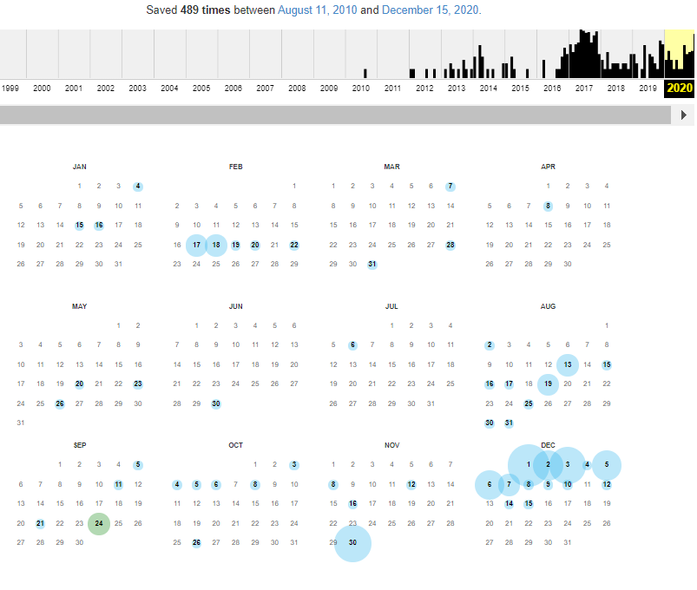
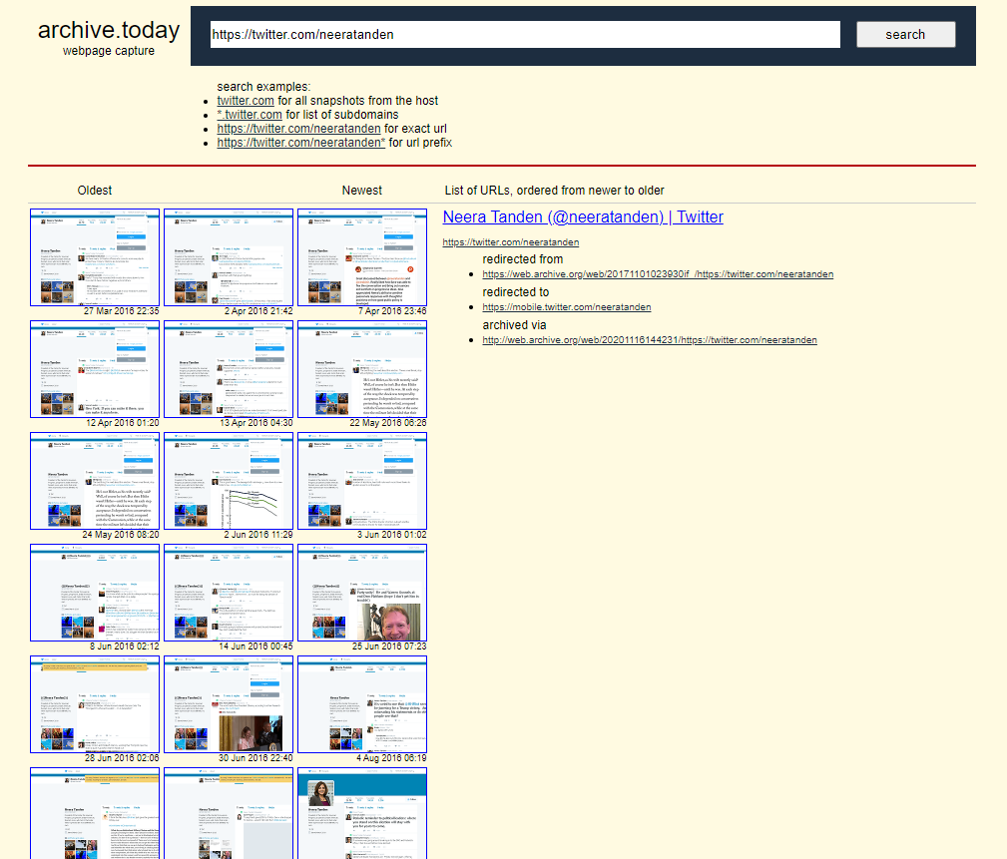
Neera Tanden’s Twitter account is well archived
> curl -s http://memgator.cs.odu.edu/timemap/link/https://twitter.com/neeratanden | grep datetime | awk '{print $1}' | awk -v FS=/ '{print $3}'| sort | uniq -c |sort -nr
489 web.archive.org
248 wayback.archive-it.org
90 archive.md
19 www.webarchive.org.uk
12 webarchive.loc.gov
1 swap.stanford.edu
http://web.archive.org/web/*/https://twitter.com/neeratanden
https://archive.is/https://twitter.com/neeratanden
Harveen Kaur CS 795: Web Archiving Forensics (Fall 2020)

Slide 7
Inflammatory tweets now deleted
Harveen Kaur CS 795: Web Archiving Forensics (Fall 2020)

Slide 8
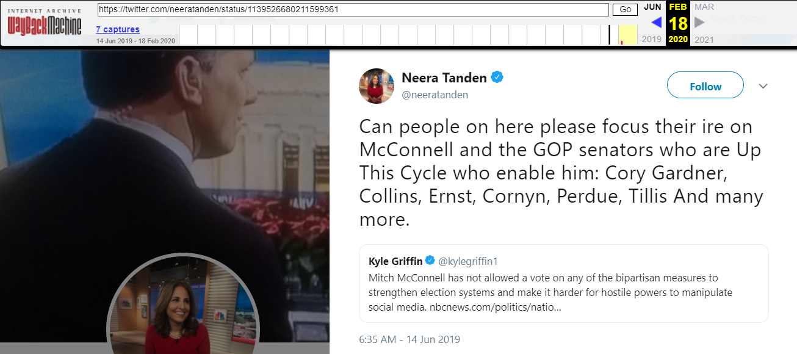
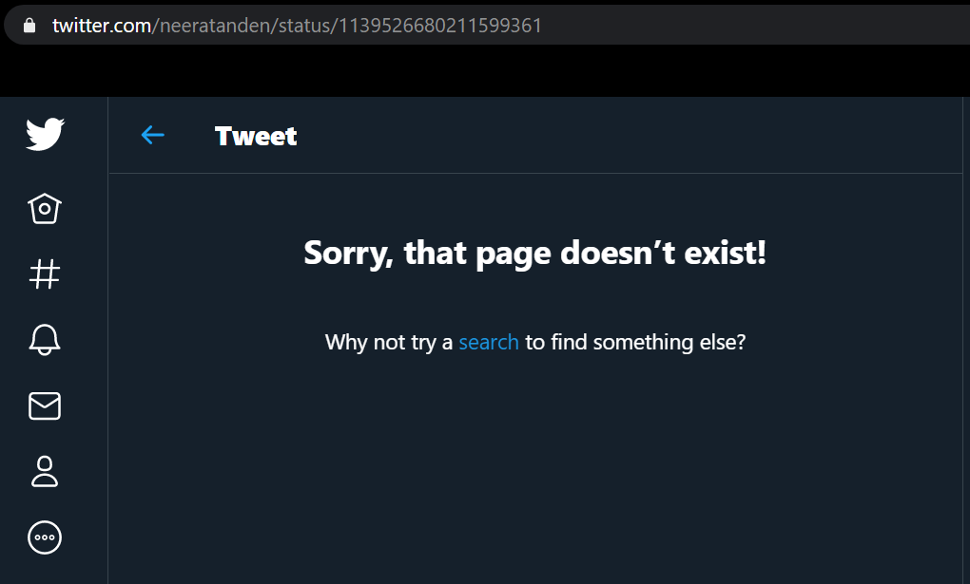
Neera Tanden targets seven Republican senators
Many of the Republicans targeted by Neera Tanden were projected to lose but managed to win
https://web.archive.org/web/20200218100156if_/https://twitter.com/neeratanden/status/1139526680211599361
Memento shared by Daily Beast
https://twitter.com/neeratanden/status/1139526680211599361
Not available on Twitter
https://www.thedailybeast.com/neera-tanden-mean-tweeted-gop-lawmakersuntil-she-needed-their-votes?ref=home
Harveen Kaur CS 795: Web Archiving Forensics (Fall 2020)

Slide 9
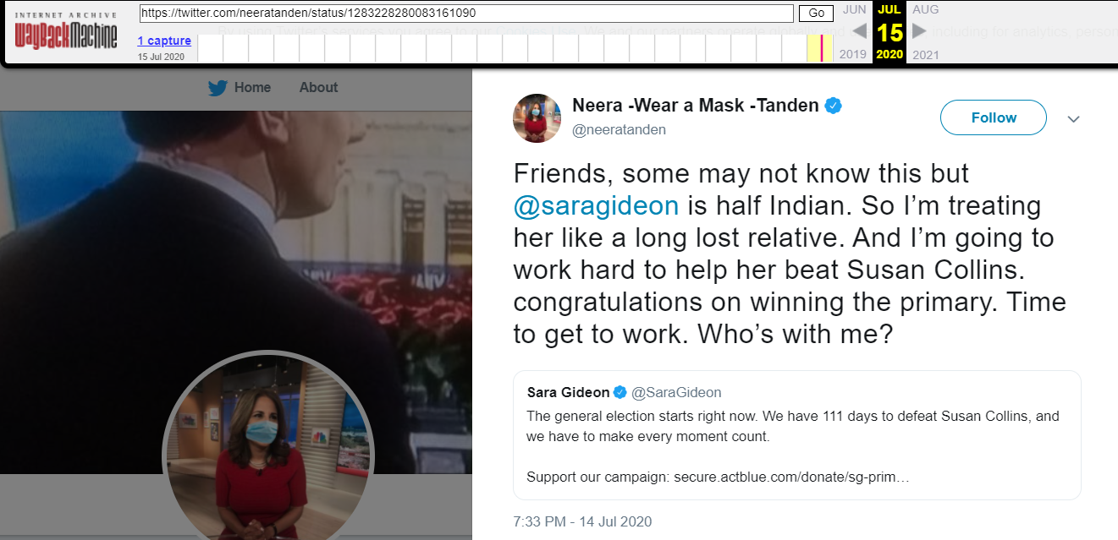
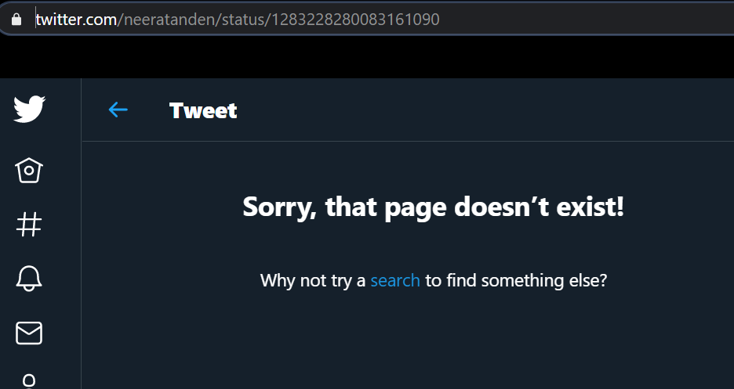
Susan Collins is a Republican senator
Susan Collins was up for reelection against Sara Gideon. Susan Collins was expected to lose.
However, Susan Collins won the election
https://web.archive.org/web/20200715024801/https://twitter.com/neeratanden/status/1283228280083161090
Memento shared by Daily Beast
https://twitter.com/neeratanden/status/1283228280083161090
Not available on Twitter
https://www.thedailybeast.com/neera-tanden-mean-tweeted-gop-lawmakersuntil-she-needed-their-votes?ref=home
https://www.vox.com/2020/11/4/21533494/senate-2020-results-maine-susan-collins-winner
Harveen Kaur CS 795: Web Archiving Forensics (Fall 2020)

Slide 10
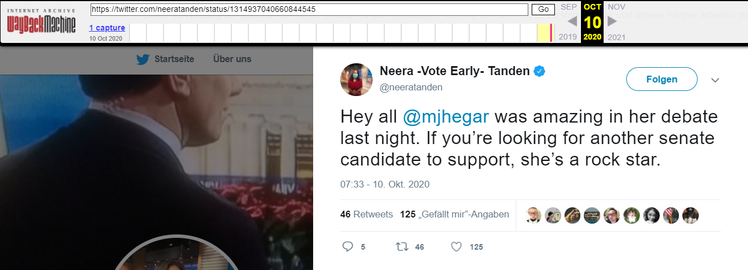
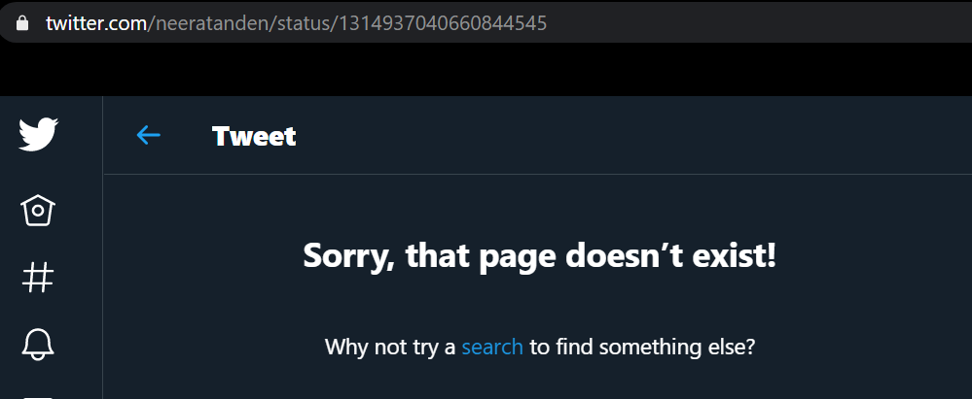
Neera Tanden has deleted tweets in support of MJ Hegar (Democrat)
MJ Hegar (Democrat) was defeated by John Cornyn (Republican) for the U.S. senate seat (Texas, 2020)
http://web.archive.org/web/20201010143738/https://twitter.com/neeratanden/status/1314937040660844545
https://twitter.com/neeratanden/status/1314937040660844545
https://www.texastribune.org/2020/11/03/john-cornyn-mj-hegar-texas-senate/
Harveen Kaur CS 795: Web Archiving Forensics (Fall 2020)

Slide 11
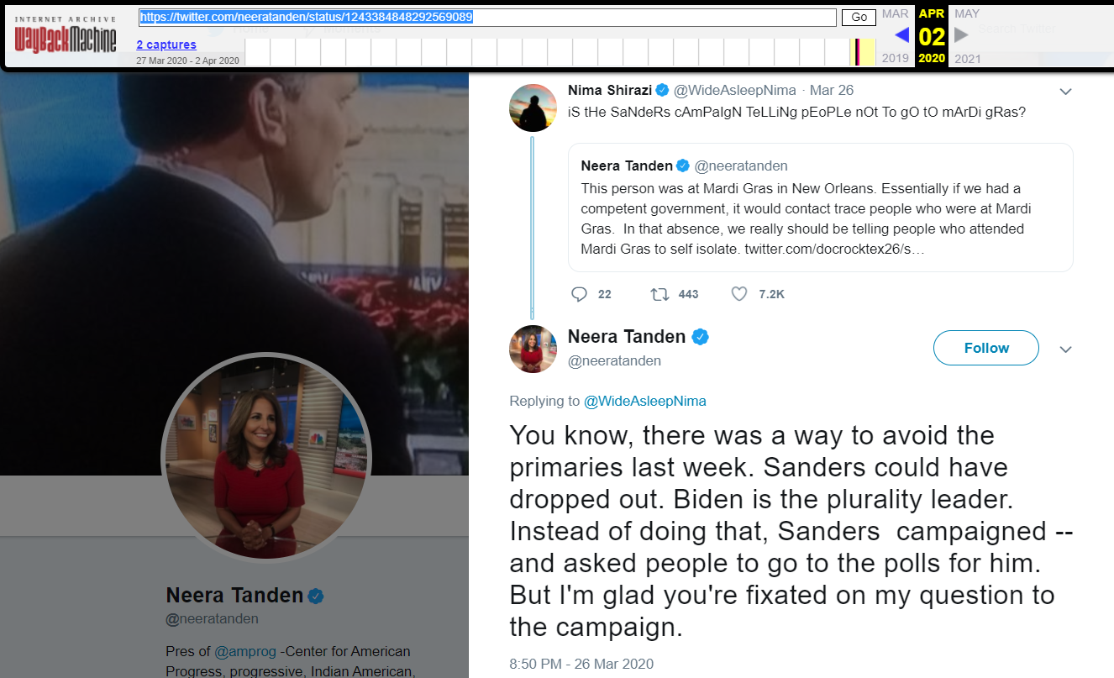
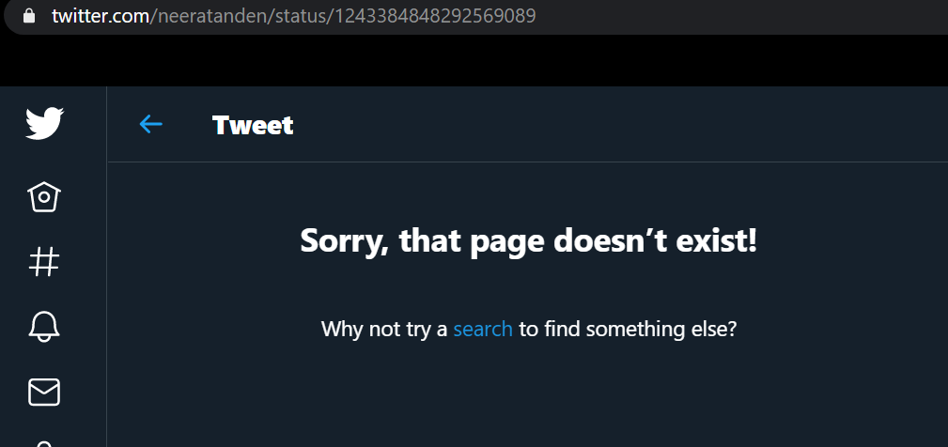
Deleted tweet targeted U.S. senator Bernie Sanders
https://twitter.com/neeratanden/status/1243384848292569089
U.S. senator Bernie Sander is a part-time Democrat has also been targeted by Neera Tanden
http://web.archive.org/web/20200402171629if_/https://twitter.com/neeratanden/status/1243384848292569089
Harveen Kaur CS 795: Web Archiving Forensics (Fall 2020)

Slide 12
Tweets active, archived, and deleted for Neera Tanden’s account
> python getActiveTweets.py > active.txt && cat active.txt | wc -l
39468
> python getArchivedTweets.py > archived.txt && cat archived.txt | wc -l
41737
> python getDifference.py archived.txt active.txt > deleted.txt
> cat deleted.txt | wc -l
2269
> cat deleted.txt | head -n 5
1009287469194534912
957619755598471168
1324831576816058368
1035725990750814208
1243146685003563008
1318521799156662274
Harveen Kaur CS 795: Web Archiving Forensics (Fall 2020)

Slide 13
Sentiment analysis of Neera Tanden’s 2170 deleted tweets

Slide 14
Analysis of the deleted tweets
Retrieved the text data for the 2170 tweets
Sentiment analysis done using the TextBlob library
“The key aspect of sentiment analysis is to analyze a body of text for understanding the opinion expressed by it. Typically, we quantify this sentiment with a positive or negative value, called polarity. The overall sentiment is often inferred as positive, neutral or negative from the sign of the polarity score.”
The polarity range is [-1,1]
https://www.kdnuggets.com/2018/08/emotion-sentiment-analysis-practitioners-guide-nlp-5.html
Harveen Kaur CS 795: Web Archiving Forensics (Fall 2020)

Slide 15
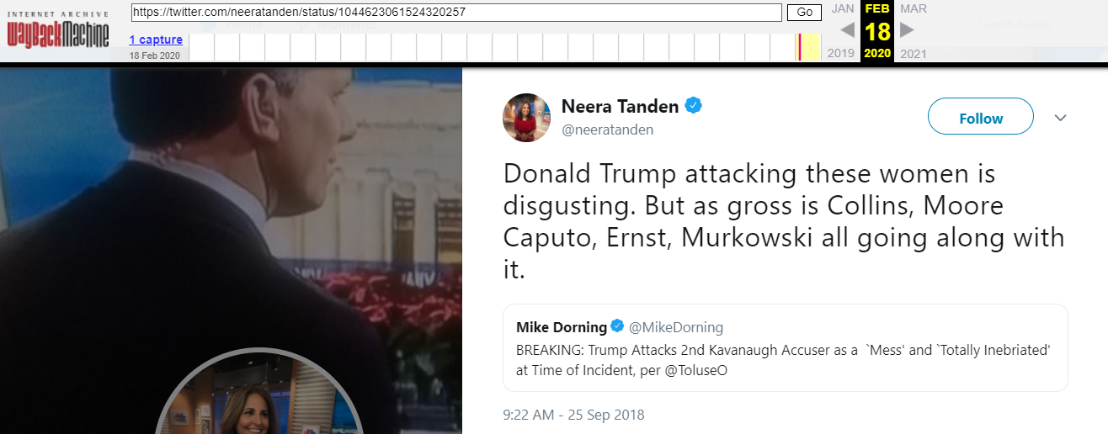
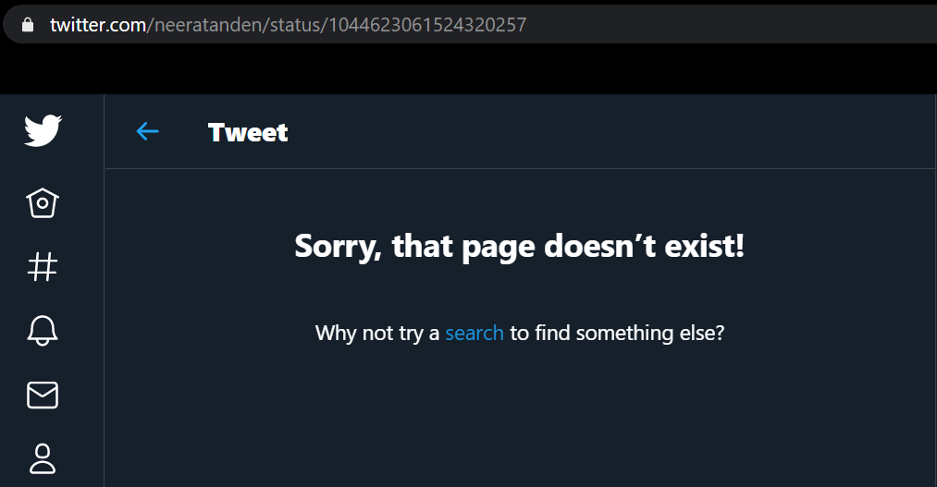
Deleted tweets with negative sentiment
Sample tweet-
{'tweet_id': 1044623061524320257, 'tweet_text': 'Donald Trump attacking these women is disgusting. But as gross is Collins, Moore Caputo, Ernst, Murkowski all going along with it.https://twitter.com/MikeDorning/status/1044618054523604992\xa0…', 'sentiment': 'negative', 'polarity': -0.5}
http://web.archive.org/web/20200218103624if_/https://twitter.com/neeratanden/status/1044623061524320257
https://twitter.com/neeratanden/status/1044623061524320257
Harveen Kaur CS 795: Web Archiving Forensics (Fall 2020)

Slide 16
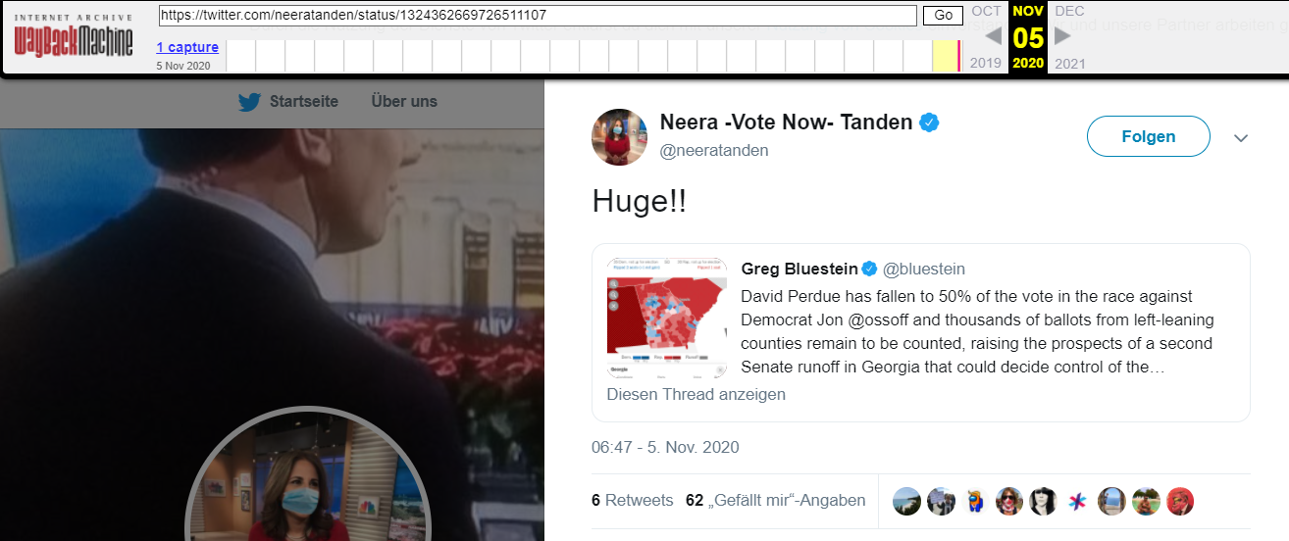
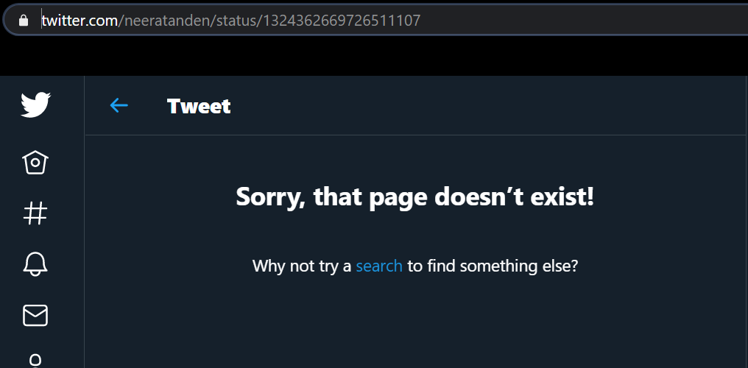
Deleted tweets with positive sentiment
Sample tweet-
{'tweet_id': 1324362669726511107, 'tweet_text': 'Huge!!https://twitter.com/bluestein/status/1324360112190951424\xa0…', 'sentiment': 'positive', 'polarity': 0.4}
}
http://web.archive.org/web/20201105144805/https://twitter.com/neeratanden/status/1324362669726511107
https://twitter.com/neeratanden/status/1324362669726511107
Harveen Kaur CS 795: Web Archiving Forensics (Fall 2020)

Slide 17
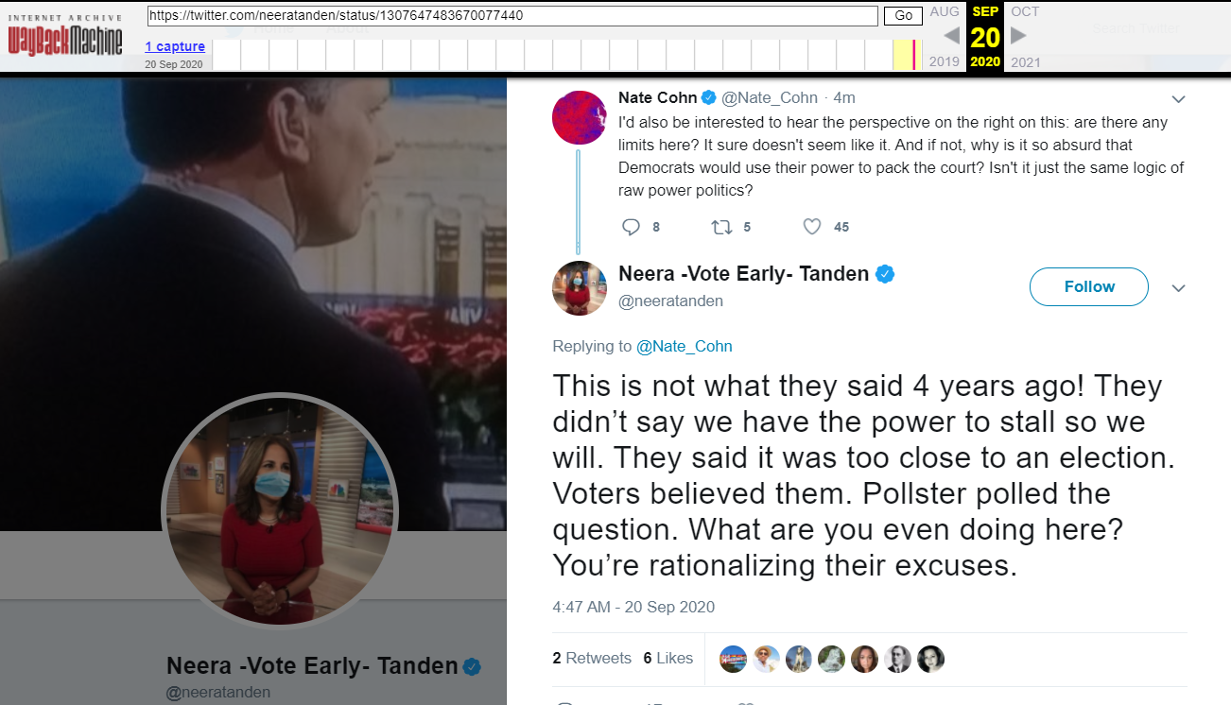
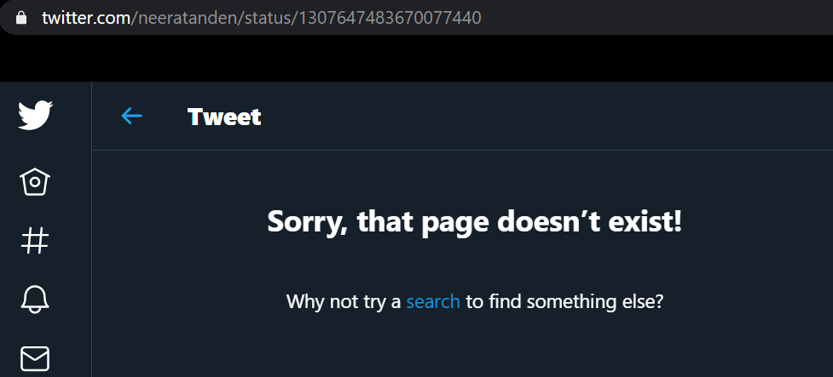
Deleted tweets with neutral sentiment
Sample tweet-
{'tweet_id': 1307647483670077440, 'tweet_text': 'This is not what they said 4 years ago! They didn’t say we have the power to stall so we will. They said it was too close to an election. Voters believed them. Pollster polled the question. What are you even doing here? You’re rationalizing their excuses.', 'sentiment': 'neutral', 'polarity': 0.0}
The result here is neutral as the text does not have inflammatory words
http://web.archive.org/web/20200920114848/https://twitter.com/neeratanden/status/1307647483670077440
https://twitter.com/neeratanden/status/1307647483670077440
Harveen Kaur CS 795: Web Archiving Forensics (Fall 2020)

Slide 18
Sentiment analysis is not 100% accurate
We cannot rely on sentiment analysis completely due to these factors:
The context of the sentence
Sentence ambiguity
Sarcasm
Comparative statements
https://brnrd.me/posts/sentiment-analysis-never-accurate
Harveen Kaur CS 795: Web Archiving Forensics (Fall 2020)

Slide 19
Percentage of tweets that fall into the three different categories
Tweets with positive sentiment- 40.47% (approx.)
Tweets with negative sentiment- 24.47% (approx.)
Tweets with neutral sentiment- 35.06% (approx.)
Harveen Kaur CS 795: Web Archiving Forensics (Fall 2020)

Slide 20
Takeaways
Neera Tanden’s Twitter account is archived well
Now that her future job depends on their approval, Neera Tanden has deleted tweets that were critical of U.S. senators
Neera Tanden deleted tweet that supported MJ Hegar (Democrat) after she lost to John Cornyn
Neera Tanden has deleted tweets that targeted U.S. senator Bernie Sanders who is a part-time Democrat
Sentiment analysis shows that 24.47% (approx.) of tweets deleted by Neera Tanden were negative
We cannot rely on sentiment analysis completely due to factors like context, sentence ambiguity, sarcasm, and comparative statements
https://brnrd.me/posts/sentiment-analysis-never-accurate
Harveen Kaur CS 795: Web Archiving Forensics (Fall 2020)

